Slide 1



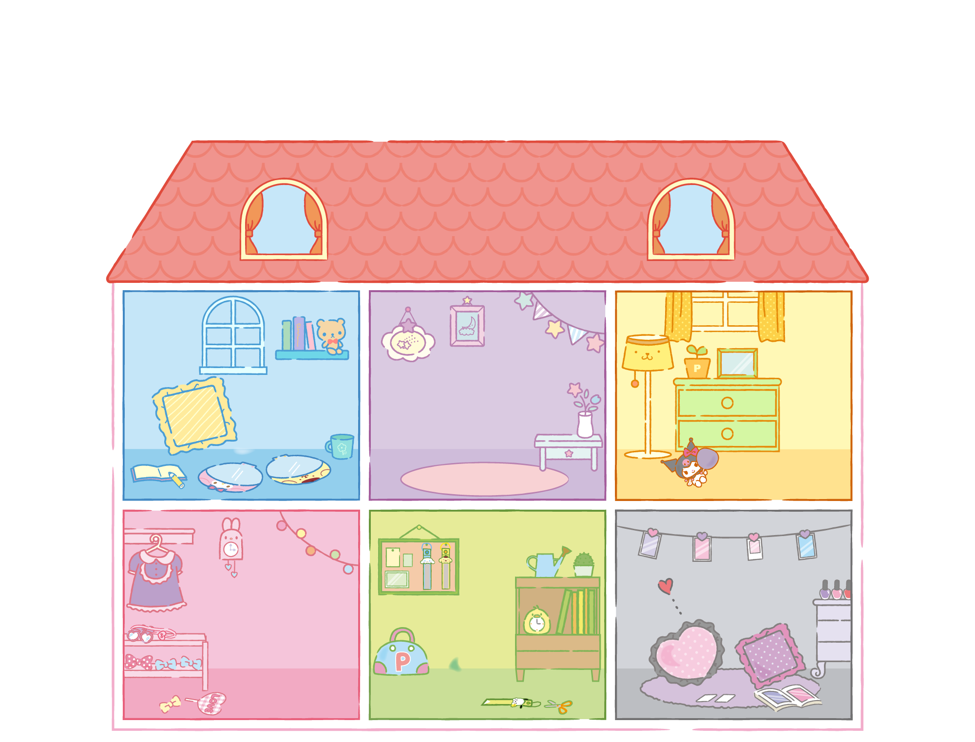






Girl Math
ECONOMIC PRINCIPLES

Slide 2


Agenda

Slide 3

$45 gym classes are cheaper than $200 of therapy
Hello Kitty

Slide 4

$45 gym classes are cheaper than $200 of therapy
Cinnamoroll

Slide 5

Anything under $5 is free
Twin Stars

Slide 6

Make money by skipping daily coffee
Pompompurin

Slide 7

If you use a $300 item every day, it’s free
My Melody

Slide 8

Items bought with refunded money is free
Pochacco

Slide 9
You’re losing money if you don’t qualify for free shipping
Kuromi

Slide 10




ALL DRESSES ARE
50%
OFF
Don’t need to buy 2 pieces
Don’t need to worry about matching shirts/pants

Slide 11



BOUTIQUE GYM CLASSES ARE AN INVESTMENT
($45 to get yelled at for an hour is cheaper than $200 of therapy )
therapy

Slide 12




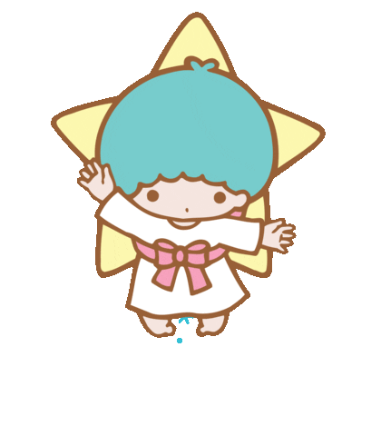

ANYTHING PAID WITH CASH IS FREE
There is no proof of spending in your bank account

Slide 13




MAKING MONEY
You’re
whenever you skip your daily coffee run

Slide 14






COST PER WEAR
If you use a $300 purse every day, it’s only $1 per day.
If you sell it for $300, it’s
basically free.

Slide 15


SUNK COST
If I buy something with money I got back from a refund, that item is
free.

Slide 16


You’re losing money if you don’t buy something that is on sale
You’re losing money if you don’t spend enough for free shipping

